Slide 1



From index to impact?
Process tracing the policy impact of the Hunger And Nutrition Commitment Index (HANCI)
Dolf te Lintelo
Institute of Development Studies (IDS)
Email: d.telintelo@ids.ac.uk
Twitter: @d_telintelo
10 November 2016
Notes:
Introduce myself, + backstory: not an evaluation specialist
In recent years, the global literature on reducing hunger and malnutrition has come to view
progress as much an outcome of a political process as of (nutrition) technical interventions.
Political commitment is now seen as an essential ingredient for bringing food and nutrition
security higher up on public policy agendas (FAO, IFAD and WFP 2013, 2014; Foresight
2011; Gillespie, Haddad, Mannar, Menon and Nisbett 2013; IFPRI 2014; te Lintelo, Haddad,
Leavy, Masset and Stanley 2011; te Lintelo, Haddad, Lakshman and Gatellier 2014; te
Lintelo and Lakshman 2015).

Slide 2
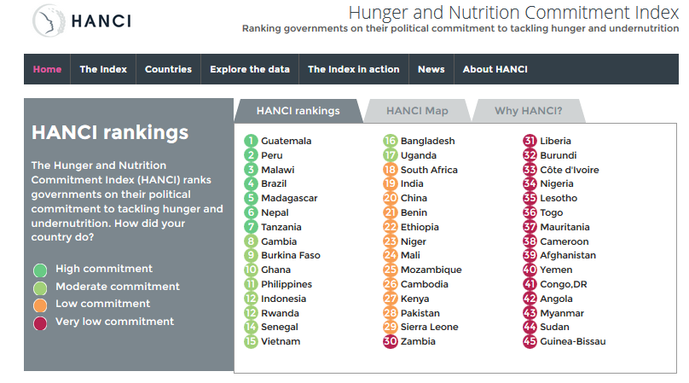
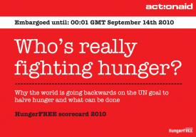



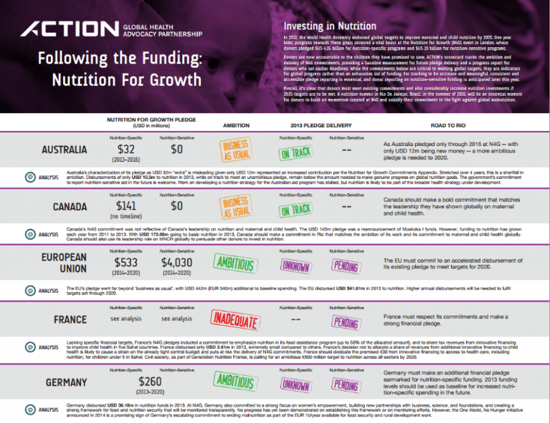
Commitment metrics & tools proliferate
Notes:
As a consequence, a range of new indicators and scorecard tools have proliferated seeking to promote accountability and transparency of policy, legal and spending efforts and outcomes in the battle to reduce hunger and malnutrition.
The use of these metrics is widely viewed as enhancing accountability of governments, donors, civil society and private sector organisations for actions addressing, for instance, human rights and business environments as well as hunger and nutrition. International organisations and aid donors also use these tools to inform decisions on funding and programmatic action. Yet, so far, few efforts have been made to understand the effects and impact of these indicators on global, regional or in-country hunger and nutrition policy.
EXPLAIN POPULARITY:
* Monitoring outcome measures does not promote strong enough accountability for governments
* Beyond outcomes: Measuring political commitment to H&N can foster accountability and enabling environments
Examples of these metrics include the World Health Organization’s (WHO) nutrition landscape analyses (Engesveen, Nishida, Prudhon, & Shrimpton, 2009), the Hunger Free scorecard (ActionAid, 2009, 2010), the Hunger Reduction
Commitment Index (te Lintelo, Haddad, Lakshman, & Gatellier, 2014; te Lintelo et al., 2011); the Nutrition Barometer (Save the Children & World Vision International, 2012); the Hunger and Nutrition Commitment Index (te Lintelo,
Haddad, Lakshman, & Gatellier, 2013, 2014); the Political Commitment Rapid Assessment Tool (Fox, Balarajan, Cheng, & Reich, 2015) and the Global Nutrition Report’s review of Nutrition 4 Growth Summit commitments (IFPRI,
2014).

Slide 3
The impact of FNS metrics on policy: often assumed, rarely explored
This talk:
Reflects on insights from literature on the effects of ‘indicators’
Presents a case study for HANCI
Adopts and reflects on a PT methodology

Slide 4
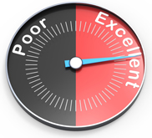
‘Indicators’: what are they, why are they used?
  “the selection, compilation, simplification, aggregation, filtering and naming of the resulting numeric product, which can then be used to evaluate performance of states, private sector actors, international bodies” etc (Davis et al. 2012).
  They can:
  draw attention to social problems, social justice and reform strategies
  hold leaders accountable to international standards
  offer rigorous analysis of causes/ consequences of policy interventions
  inform decisions about allocations, from foreign aid to FDI
Notes:
There is now broad consensus that indicators are valued by policymakers, researchers and reform-oriented civil society groups and private sector organisations value:
In the field of governance and human rights in international development, examples of prominent indicators include: the World Bank’s Ease of Doing Business Index and
Worldwide Governance Indicators; the United Nations (UN) monitoring reports on the Millennium Development Goals; the Corruption Perceptions Index (Transparency
International); the United Nations Development Programme’s (UNDP’s) Human Development Index; the US State Department’s Trafficking in Persons indicators; and
Freedom House’s Freedom in the World Indicators (Davis et al. 2012; Merry 2011). The International Development Association, the African Development Bank and the Asian Development Bank internally generate indicators drawing on the Country Policy and Institutional Assessment (CPIA) figures to develop algorithms used to allocate aid across countries (Davis 2014). The UN’s International Fund for Agricultural Development (IFAD) provides loans and grants to country programmes using an allocation system based on a formula that incorporates measures of country need and country performance (IFAD 2013). In the private sector, metrics are used in corporate social responsibility efforts (e.g. the UN Global Compact or the Access to Nutrition Index) and credit rating agencies use them to advise investors on political risks. Civil society groups increasingly use metrics as they are pressured by funders demanding demonstration of quantifiable and measurable evidence of their activities’ impact (Merry 2011).

Slide 5
Growing popularity of ‘indicators’
Increasing accessibility and quality of social and economic statistics
Declining cost of computing
Responds to donor demands about ‘evidence informed policy’
  Data = ‘the lifeblood of decision-making and the raw material for accountability’ (Independent Expert Advisory Group 2014: 2).
Instruments of soft power (Kelley and Simmons 2015).
Notes:
As indicators are becoming commonplace, an emerging body of research now seeks to
understand their normative, theoretical and practical implications. It asks, how do they
influence attitudes, beliefs, social relationships and decisions, and what are the political and
economic consequences? What social processes surround the creation and use of
indicators? How do indicators influence the nature of standard setting and decision making?
How do they affect the distribution of power between and among those who evaluate and
those who are evaluated? What is the nature of responses to such exercise of power,
including forms of contestation and attempts to regulate the production or use of indicators
(Davis 2014; Davis et al. 2012; Kelley and Simmons 2015; Merry 2011)?

Slide 6
Indicators influence public policy
Growing body of evidence: influential when based on systematic monitoring, comparative (quantitative), wielded by a respected actor, and widely disseminated
Policymakers use rankings because popular/political debates interpret index rankings as accurate, despite high levels of underlying uncertainty
Decisions based on indicators can be presented as efficient, consistent, legitimate, transparent, scientific and impartial
Most analyses focus on indicators as dependent variables
There is a distinct need to treat ‘metrics as explanatory variables and look for their impact on specific policy innovations’ (Kelley and Simmons 2015: 68).
Notes:
Policy actors recognise that indicators may be superficial, misleading or wrong, yet still decide to use them
Examples: For instance, Davis (2014) notes that the World Bank claims that it has prompted many countries to reform their legal systems simply by promoting its country-level indicators on the Ease of Doing Business Index. Various states have advertised their achievements climbing rankings of the Ease of Doing Business Index in The Economist newspaper. There are also cases of policy reform motivated by the objective of raising countries’ rankings on the Corruption Perceptions Index (Galtung 2006) and the Doing Business indicators (Schueth 2011). The US State Department’s Trafficking in Persons Report also claims that it has fostered national anti-trafficking legislation in many developing countries (Davis et al. 2012). Kelley and Simmons (2015) scrutinised this claim and innovatively used factor analysis6 to find statistically significant correlations between countries’ performance in annual reports and subsequent government criminalisation of human trafficking. They notice that states are sensitive to monitoring, respond faster to harsher ‘grades’, and react when their grade first drops below a socially significant threshold.

Slide 7
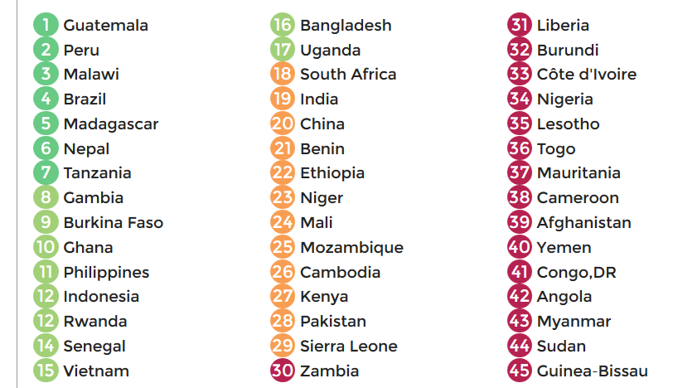
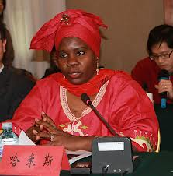

Hunger And Nutrition Commitment Index (HANCI)
Notes:
Accordingly we seek to explain if HANCI affects policy
Explain what HANCI does – measuring commitment, using different kinds of secondary and primary data, build credible evidence
Discuss the theory of change of HANCI
Since 2013, six HANCI evidence reports have been published by IDS. Annual Global HANCI reports set out rankings of the political commitment to reduce hunger and undernutrition for 45 developing countries with high burdens. A further report analyses political commitment within a subset of five countries: Tanzania, Zambia, Malawi, Bangladesh and Nepal, drawing on in-country expert surveys (te Lintelo and Lakshman 2015). A parallel donor index of 23 Organisation for Economic Co-operation and Development (OECD) countries was presented in 2013 and 2014. Moreover, a range of partnership activities has taken place in six countries.

Slide 8
What do we mean by policy impact?
(1) a change in the framing of the policy problem;
(2) a change in agenda-setting processes;
(3) a change in policy content;
(4) a change to resource allocation;
(5) a change to policy implementation
(Sumner et al 2011)
Notes:
While most analyses of substantive policy change such as new policies, laws or budgets offer ex post facto explanations, no such impacts are as yet observed relating to the HANCI.
Some reports now argue that the influence of indicators and external assessments is greatest at the agenda-setting stage of the policy process (Parks et al. 2015). Our focus is
hence on impact in terms of (1) framing and (2) agenda-setting processes. We hypothesised
that HANCI evidence and project activities may influence how policy stakeholders frame
hunger and nutrition as issues of political commitment. We further hypothesised that
adoption of HANCI evidence in targeted policy advocacy will influence policy elites, who in
turn may adopt their framings and/or set new policy agendas

Slide 9
Assessing policy impact: causality hard to establish
“Prima facie evidence of their influence can be found in their contestation” (Hansen and Muehlen-Schulte 2012: 458)
No observable counterfactual
Hard to observe causality between indicator and beliefs, attitudes and social interactions of policy stakeholders
Decision-makers may present data to justify a decision after the fact or display symbolic commitment to evidence-based decision making
Causality challenge generally applies to questions of research to policy impact (deLeon and Weible 2010:25), as well as policy advocacy to policy change (Nathan et al 2002).
Notes:
just as it is hard to link any complex policy decision back to a specific research study (deLeon and Weible 2010:25), establishing causality between policy advocacy and policy change is generally understood to be difficult (Nathan et al 2002).
Hard to observe causality between indicator and beliefs, attitudes and social interactions of policy stakeholders
even in cases where indicators are cited in prominent media outlets, we do not know if their audiences’ beliefs or attitudes change as a consequence.
when political leaders or agencies claim to use indicators as criteria for making important decisions or as reasons for undertaking reforms, it can be a challenge to determine their veracity.
actors often use diverse types/sources of data in policy decisions

Slide 10
Process tracing the policy impact of HANCI
A systematic qualitative method of enquiry that can be applied to complex contexts with competing causal explanations (Beach and Pedersen 2013).
We adopt a theory testing approach to PT, within a single case research design
Posit a causal mechanism that connects an independent variable X and a dependent variable Y
Subjectivity inherent to PT
But Bayesian inferential logic enhances confidence in the validity of the proposed causal mechanism
Notes:
The HANCI has multiple components (e.g. rankings, scorecards, expert survey evidence), multiple implementing agencies (within country and international), incorporates multiple causal processes, and works differently in different contexts.
Beach and Pedersen identify three types of PT: case-explanation, theory building and theory testing. We employ a theory testing PT approach within a single-case research design. Drawing on the literature review discussed in Section 1, we postulate the general causal
mechanism for how indicators (independent variable X) influence policy elites (dependent variable Y). We propose that the causal mechanism is broadly applicable across a range of policy contexts and a range of indicators. We then apply and test the theory, using the case of the HANCI, assessing whether the theorised mechanism is actually present, and whether it functions as expected.
this report is a self-evaluation, implying a risk of bias in over-reporting success and
under-reporting failure of the project activities to achieve policy impact. We aim to contain
such risk by employing a process-tracing approach in which we identify anticipated and
actual findings, and by critically investigating the strength of the evidence that we present in
terms of its uniqueness and sufficiency to explain the observed policy impact. We
conservatively interpret evidence of impact and are open where impact has not been
achieved as would be expected.

Slide 11
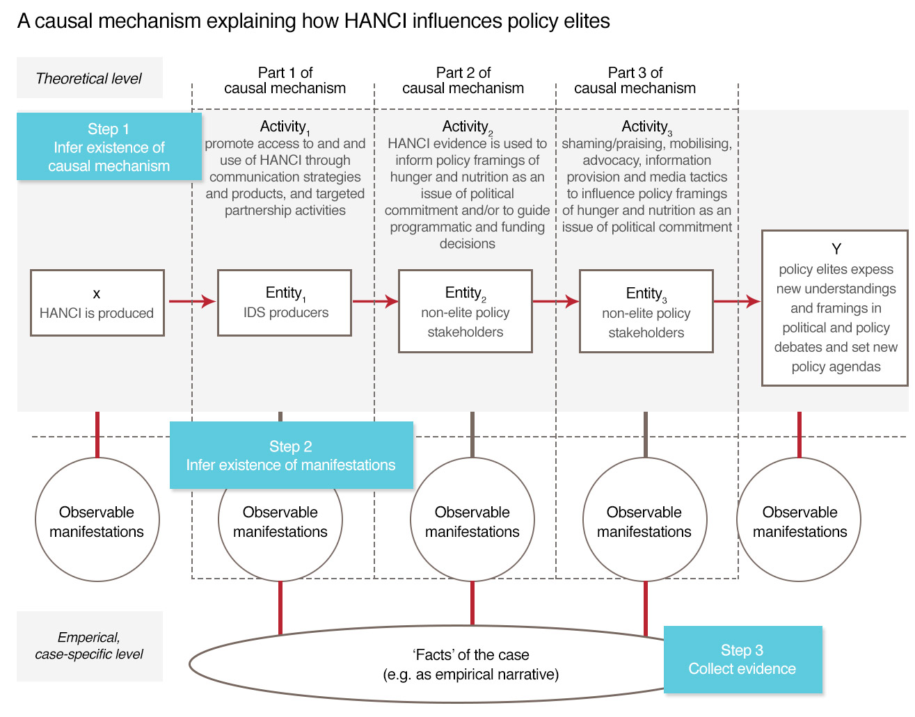
Notes:
This causal mechanism is a generic causal mechanism, and here applied to HANCI. We break it down in 3 parts, discuss this as well as X and Y.
Framing of H&N as being about political commitment

Slide 12
Testing the causal mechanism
observe for each part (a) whether the mechanism is present or absent in the case, and (b) whether the mechanism functioned as expected
However, this does not allow us to make logical claims about whether the mechanism (e.g. HANCI) is sufficient, or necessary to explain Y (Beach and Pedersen 2013:15–18).
We therefore hypothesise each part of the causal mechanism and test it
We look for evidence that maximises certainty and uniqueness (necessary and sufficient).
Uniqueness involves empirical predictions that have low likelihood and cannot be explained by other theories.
Certainty: What evidence has to be necessarily present in the case for the theory to be correct? (hoop tests)
Look for both confirming and disconfirming evidence
Notes:
In order to make plausible claims about the validity of the mechanism we need to observe for each part (a) whether the mechanism is present or absent in the case, and (b) whether the
mechanism functioned as expected; that is, whether the parts of the postulated mechanism
were present or absent. However, this does not allow us to make logical claims about
whether the mechanism is sufficient, or necessary to explain Y (Beach and Pedersen 2013:
15–18). We therefore hypothesise each part of the causal mechanism and identify evidence
that we expect to see if the part is valid, which is then tested for. However, not all evidence is
of equal relevance and we need to test for its inferential strength along two dimensions. We
are looking for evidence that maximises certainty and uniqueness or, to put it another way,
that is necessary and sufficient. Barnett and Munslow (2014: 19) review the literature to
summarise these dimensions as follows: uniqueness involves empirical predictions that
cannot be explained by other theories/mechanisms. Hence, if such evidence is found, this
has confirmatory power for that part of the causal mechanism. Uniqueness corresponds to a
low likelihood ratio. Certainty, on the other hand, seeks to establish what kind of evidence is
expected to be observed if the causal mechanism is true. What evidence has to be
necessarily present in the case for the theory to be correct? Hence, if such evidence is not
found, the test will disconfirm the existence of that part of the causal mechanism. When
testing causal mechanisms we thus seek evidence that would (be minimally needed to)
confirm the hypothesis (providing certainty) and which kind of evidence would disconfirm it,
and then identify tests for uniqueness.

Slide 13
Independent variable X: HANCI evidence is produced
Notes:
MANIFESTATION: Just an example of the kind of knowledge products produced in a particular year: reports, scorecards, film, slideshows, podcasts, website, etc.

Slide 14
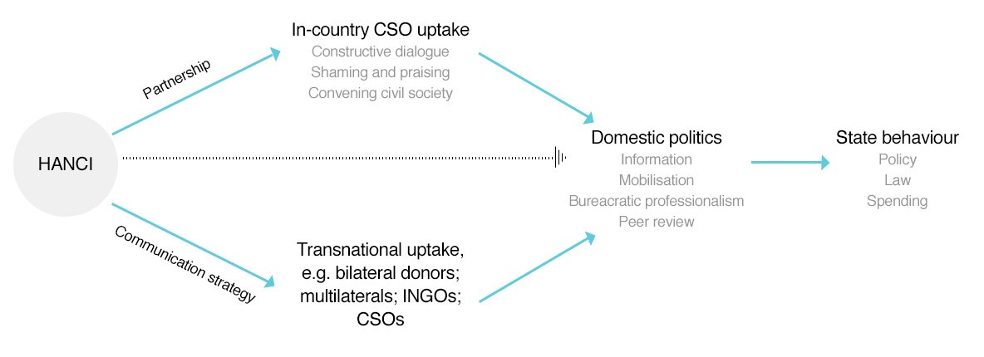
Part 1: IDS producers promote policy stakeholder access to and usage of HANCI through communication strategies and products, and targeted partnership activities
Notes:
Usage of indicators is enhanced by communications products that are relatively simple, free of charge, presented in user-friendly formats, claim originality and innovation, and for which complementary products such as online analytical tools are readily available.
we posit the central importance of partnership approaches to support comprehension, uptake, and to influence policy reforms.
To reach these stakeholders, a communications strategy was
devised in 2013.
International press releases were developed to announce key findings for each of the annual
developing country and donor reports. These were launched at strategic moments such that
evidence could inform policy debates and carry media appeal. For instance, shortly before
the Irish government chaired the European Union and hosted a conference on climate
justice, food security and nutrition in Dublin in April 2013; before the British government
hosted the G8 and organised a London ‘Hunger Summit’ in June 2013; and prior to the
Lancet Series on Nutrition launch in May 2013, where HANCI findings featured in a paper by
Gillespie et al. (2013). Furthermore, country-specific launches of the HANCI were led by
CSO partners and joint press releases were developed with partners in Bangladesh (twice)
and Zambia.
Dissemination activities targeted two uptake routes (Figure 3.1). The first
aimed at international audiences. Stakeholders with advocacy or research agendas in the
area of hunger and nutrition were identified and connected with. For instance, INGO
advocacy departments engaged in global campaigns such as: Save the Children’s Everyone
Campaign; Oxfam’s GROW campaign; the IF campaign of a collective of 240 British INGOs;
and Generation Nutrition, an international campaign led by Action Against Hunger, and
international networks such as the Scaling Up Nutrition (SUN) campaign.
In target countries, sequenced workshops initiated critical deliberation of HANCI findings with professionals from across agriculture,
sanitation, health, nutrition, social protection, women’s development, education, finance and
other sectors. A first workshop engaged CSO partners and federated members to explore
the (appeal of) HANCI evidence such as the country scorecards,19 the index rankings and
the expert survey findings. A subsequent workshop developed three or four priority advocacy
messages underpinned by HANCI evidence, rooted in partners’ existing advocacy strategies
and current priorities.

Slide 15
Why would researchers wish to partner with advocacy groups to influence policy?
Successful research to policy mobilisation involves (Crewe and Young 2002):
  understanding context inc. the politics and institution
  good quality research evidence
  effective links between researchers, knowledge brokers and policy makers.
Researchers have no monopoly over knowledge production and communication
Policy impact usually takes place over time and requires significant, strong, purposeful advocacy efforts (Court and Young 2003)
“some of the best example of success have arisen when researchers and civil society work well together” (Saxena 2005)
researchers often fail to cultivate support from key allies to influence policy (Klugman 2011).

Slide 16
Hoop tests (necessary evidence) part 1
Hoop test | International | Bangladesh | Zambia
HANCI communications strategy | Pass | Pass | Pass
Simple, free, original, user-friendly communications products | Pass | Pass | Pass
Targeted partnership activities | n.a. | Pass | Pass

Slide 17

Notes:
The second uptake route focused on five target countries located in global hunger an undernutrition hotspots in East Africa and South Asia. In Bangladesh, Nepal, Malawi, Tanzania and Zambia partnerships were developed with in-country civil society organisations and collectives who were already involved in policy advocacy regarding hunger and nutrition.
Civil society collectives as compared to individual organisations offer critical mass for engagement with governments and opportunities for greater spread and speed of dissemination of research evidence, through federated members.
Moreover country-specific diagnostics exert greater influence in shaping policy reform priorities than cross-country benchmarking efforts17 (Parks et al. 2015).
Recent research affirms this approach, in that it finds that the primary reason for external assessments to have policy influence is because they align with the priorities of policy elites: ‘senior-level decision-makers are selective and strategic about
the assessments they use, paying more attention to assessments that align with pre-existing government interests, policies and programs’ (Parks et al. 2015: 9).
Partners showcase lessons on advocacy at side-event of the SUN Global Gathering in Milan in October 2015, and in October 2016 involve in Accra event ADFNS.

Slide 18
Part 2: Non-elite policy stakeholders adopt HANCI evidence to underpin and/or adjust their policy framings of hunger and nutrition in terms of political commitment and/or to guide programmatic/funding decisions.
Hoop tests | Inter national | B’desh | Zambia
Partners use HANCI to develop new or adjust existing policy advocacy messages | Pass | Pass | Pass
HANCI registers on the radar of international agencies, practice and thought leaders, inc INGOs | Pass | Pass | Pass
Donors express an interest in funding HANCI | Pass | n.a. | n.a.
Print and social media report on HANCI | Pass | Pass | Pass
Notes:
We find that HANCI evidence has been adopted by partner organisations across countries, although in different ways. In
Zambia, the HANCI provides new evidence to support an existing policy framing of hunger
and undernutrition as being about political commitment. In Nepal, a similar policy framing of political commitment has been adopted, and it is plausible that HANCI activities and evidence contributed to this framing. In Bangladesh, the HANCI approach was seen as a
valuable example of how to structure multi-sectoral evidence that could contribute to the Right to Food Campaign; however, policy framings were not consistently expressed in terms of political commitment. However, we also conclude that the evidence suggests that HANCI
was not singularly responsible for non-elite policy stakeholders’ adoption of political commitment framings.

Slide 19
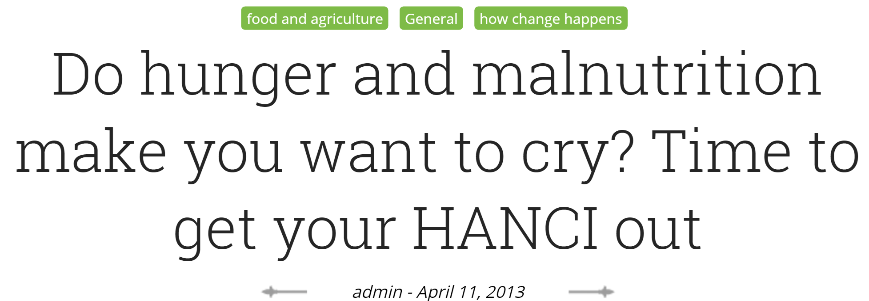
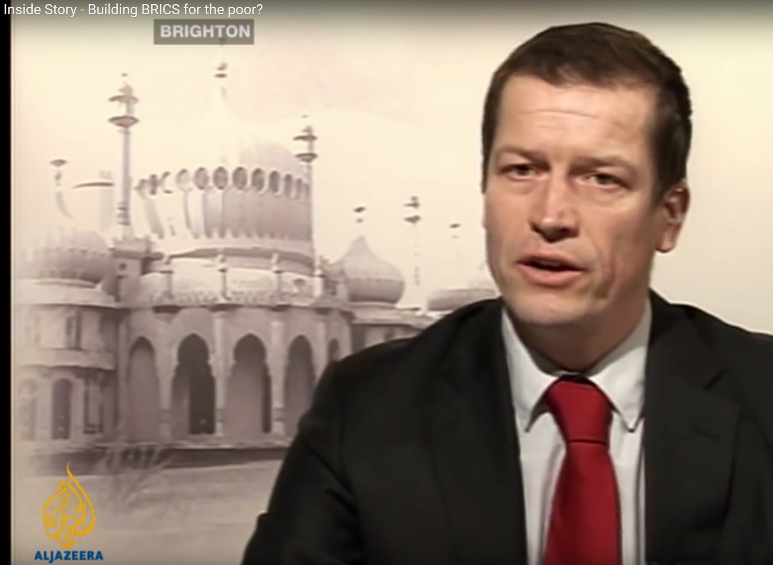
https://oxfamblogs.org/fp2p/tag/malnutrition/
Notes:
Duncan Green’s blog at Oxfam from Poverty to Power
HANCI registered with NEPAD who approached IDS for new collaboration
CIFF offered funding for a HANCI Africa

Slide 20
Hoop tests causal mechanism part 2 (cont)
Hoop tests | Inter national | B’desh | Zambia
Non-partner policy stakeholders adopt HANCI evidence | Pass | Pass | Fail*
Strategic/programme documents of non-elite stakeholders do not frame hunger and nutrition as issues of political commitment prior to HANCI | Fail | Fail | Fail
No actors other than HANCI talk about framing hunger and undernutrition in terms of political commitment | Fail | Fail | Fail
Notes:
The conclusion si that a general way of talking about H&N in terms of political commitment could not be merely the result of HANCI (non-uniqueness)

Slide 21
Part 3: Non-elite policy stakeholders employ shaming/praising, mobilising, advocacy, information provision and/or media tactics to influence policy elites’ understandings and policy framings of hunger and nutrition in terms of political commitment.
Hoop test | Inter-national | B’desh | Zambia
Partner organisations employ HANCI evidence seeking to influence policy debates and policy elites’ thinking (contracted) | n.a. | Pass | Pass
Partner organisations employ HANCI evidence seeking to influence policy debates and policy elites’ beyond contracted activities | n.a. | Fail | Pass
Non-partner organisations employ HANCI evidence seeking to influence policy debates and policy elites’ thinking | Pass | Fail | Pass
Notes:
Where we find evidence that project partners use the HANCI, this provides a fairly easy-topass
hoop test. Even though the monetary value of most partnership contracts was small
(<£10k p.a.), some may argue that employing the HANCI in various activities only happened
because of the contractual relation. A tighter hoop test would thus show partners using
HANCI beyond contracted activities, or for third parties to use HANCI for shaming/praising,
mobilising, advocacy, information provision, and/or media engagement activities.

Slide 22

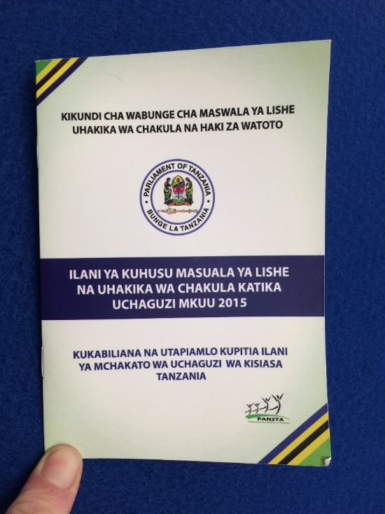
Notes:
KANCO employs HANCI to persuade First Lady of Kenya

Slide 23
Y= policy elites frame hunger and nutrition policy problems and solutions in terms of political commitment and use these framings to divine new policy agendas
Hoop test | International | B’desh | Zambia
Monitored governments publicly respond to, contest, or seek acclaim based on HANCI evidence | Pass | Fail | Pass
Senior political leaders/bureaucrats frame hunger and nutrition policy problems and solutions in terms of political commitment and/or use these framings to divine new policy agendas | Pass | Fail | Pass
Senior political leaders and/or bureaucrats report that HANCI evidence inspired them to bring hunger and nutrition higher up on political agendas. | Pass | Fail | Pass
International policy elites frame hunger and nutrition policy problems and solutions in terms of political commitment, explicitly referencing HANCI | Pass | n.a. | n.a.

Slide 24
Bangladesh
INGO used HANCI scorecard to argue for a Right to Food law and the RtF to be made justiciable in Constitution
‘We need to look at the spirit of the constitution, so I don’t care what score Bangladesh is getting’….
‘We [our programmes, ed.] are very real, I am not interested in some hypothetical issue’ (pointing to RTF indicator in HANCI).’…
‘I am not aligning our indicators to HANCI indicators – no, I am using my own indicators’.
Director general, Food Monitoring and Planning Unit, Govt of Bangladesh
Notes:
Monitored governments publicly respond to, contest, or seek acclaim based on HANCI evidence
Noting that the scorecard did not allocate highest scores to the Right to Food indicator, the respondent argued that rather than looking at the letter of the law,
Accordingly, there is no evidence that senior bureaucratic and political leaders adopted the framing of hunger and undernutrition as being about political commitment. Moreover, while the Government of Bangladesh responded to HANCI evidence, it did not do so in a public manner.
the government ‘don’t believe in the [RtF] law to be framed. We [already, ed.] pursue Right to Food: through markets, through social protection, through pursuing the right food quality’.

Slide 25
Zambia
In August 2014, the CSO-SUN Alliance organised meetings with eight cross-party MPs to present HANCI and the co-constructed advocacy demands.
‘How are we doing worse than Ethiopia? Or Rwanda?’
‘HANCI is a very good tool to help us qualify how well we are doing – [we] can worry about the specific data that is included, but this provides us with a framework to think through how we can be improving our commitment’ (pers.comm., Honorable Hamududu, MP, August 2014).
Subsequently, an All Party Parliamentary Caucus on Nutrition was set up, whose statute has six objectives, one of which seeks ‘to enhance political will and accountability to address the burden of malnutrition’.

Slide 26
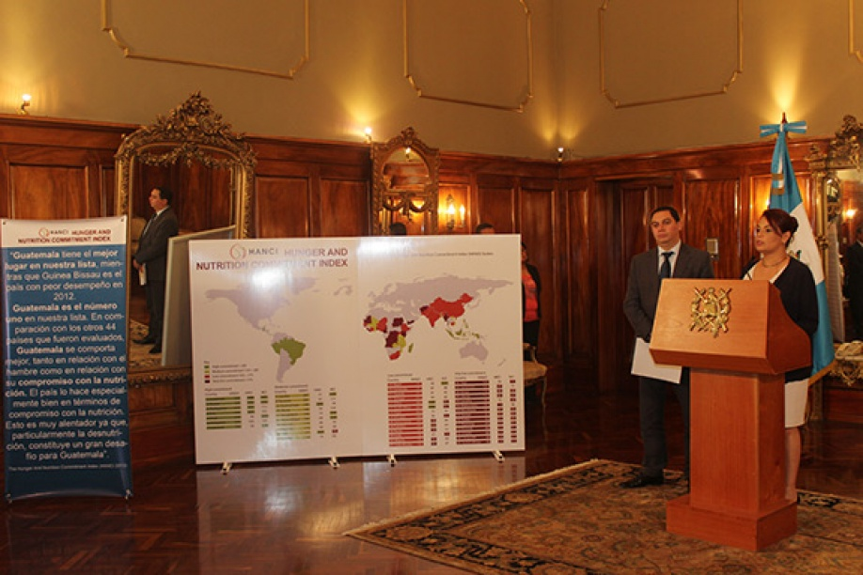
Guatemala: HANCI in presidential elections 2014
Notes:
Vice President – use of HANCI in presidential elections 2014

Slide 27

Development Partners use HANCI
“I also congratulate the Government of Malawi on its performance in the annual Hunger And Nutrition Commitment Index…..Malawi lies third on the index… I believe that this level of commitment, with the right policy choices and support, can translate into equally impressive progress in reducing malnutrition in the coming years.” (2014)
Notes:
Development partners use HANCI

Slide 28
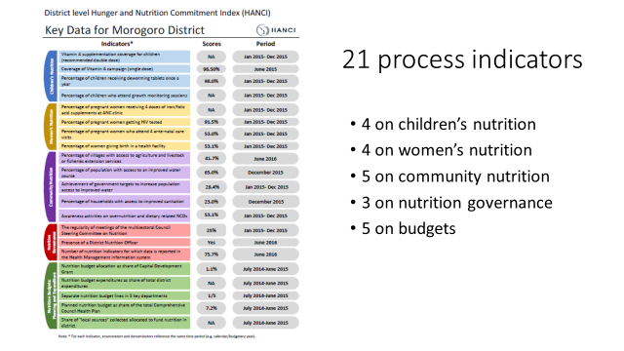

Exploring a collaboration with Government of Tanzania on national nutrition scorecard
HANCI selected as key nutrition governance indicator in Global Monitoring Framework on Maternal, Infant and Young Child Nutrition (WHO, 2014)

Slide 29
Reflections and conclusion
PT encourages a systematic, rigorous approach to demonstrating HANCI’s contribution rather than attribution to changed elite policy framings
However, policy processes are complex and dynamic, and in-depth analysis could further strengthen insights in role of HANCI
Limitation: evaluators = researchers
HANCI offers two innovations for studies of indicators:
shifting from shaming to praising
supporting users in understanding its limitations through partnership approaches

Slide 30
Partnership approaches enabled HANCI to overcome key critiques levied at indicators
Optimise relevance: exercises interrogated the validity and usefulness of each piece of evidence to build capacity understanding the evidence, and ability to use it
Demystify the research evidence and to break down barriers between (academic) producers and (practitioner) users.
Good advocacy asks are sensitive to country contexts: e.g. reference government policies and strategies for better leverage
Partners’ credibility engaging domestic policymakers rests on having up-to-date data at their disposal, ideally data already published by governments. This also led to vetting data quality prior to publication
Supporting partners in their policy advocacy is most likely to drive policy change and sustained political commitment to malnutrition
Notes:
of the 22 indicators in the global index (using the scorecards), and the key findings from expert surveys and community voices for advocacy purposes.

Slide 31
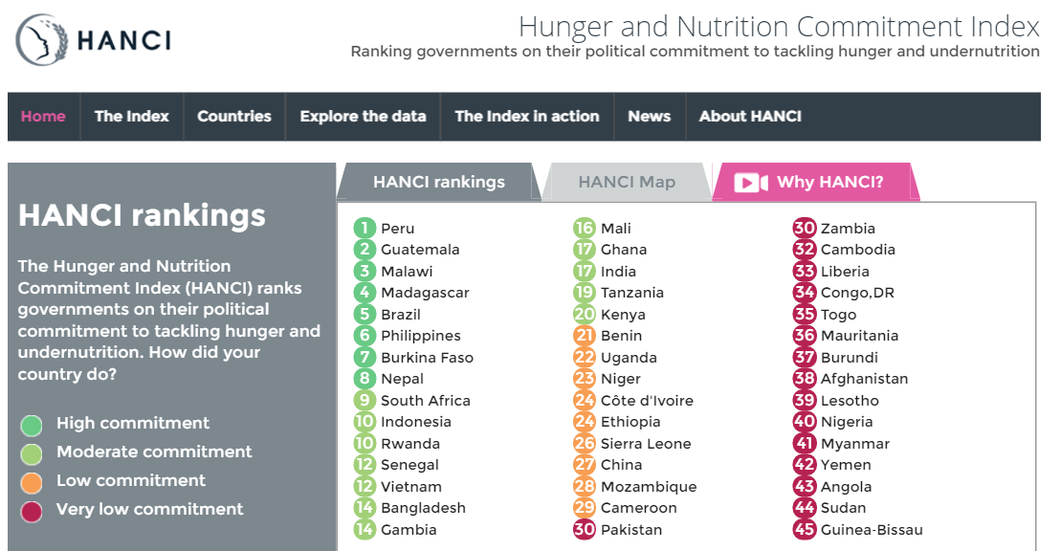
Thank you
WWW.HANCINDEX.ORG
Notes:
Annual rankings

