Slide 1



China and Africa’s Green Energy Transition:
Potentials and Barriers
Wei Shen
28/10/2020

Slide 2
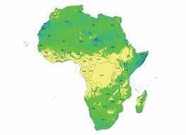
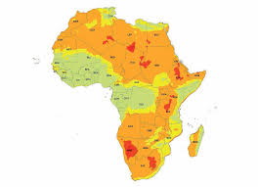
Solar PV and wind energy potentials in Africa: a silver bullet for SDG7?
Major advantages:
Evenly distributed
Locally produced
Simpler and cheaper technology
Truly renewable and infinite
GHG emission reduction
Flexibility in application
Challenges:
2 trillion is needed by 2040 (IEA, 2019)
Technology breakthrough
Institutional development
(Source: IRENA and KTH-dESA , 2014)

Slide 3
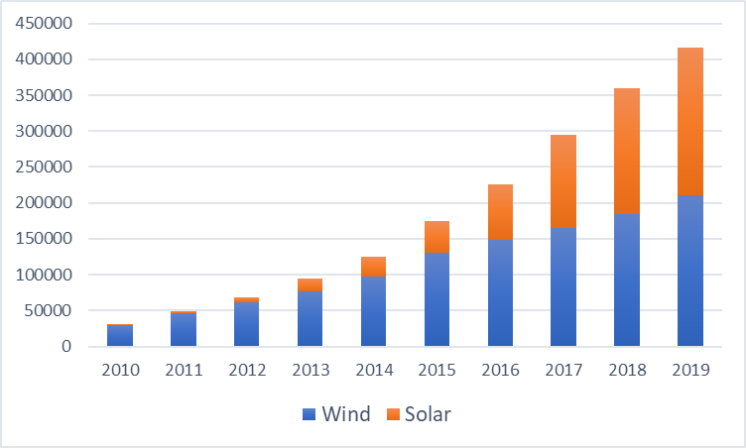
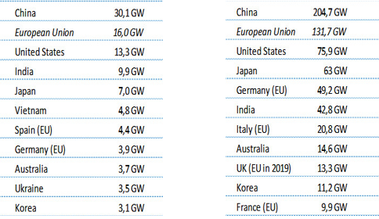
Is China winning the global green energy race?
Solar PV and wind energy installed capacity in China
Top 10 countries for annual and accumulative solar PV instalment
Source: IRENA Statistics Yearbook 2020
Source: IEA, 2020

Slide 4
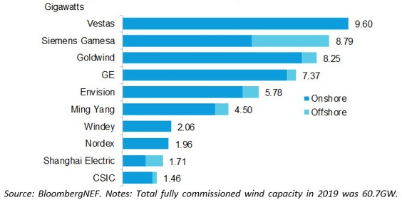
China’s technology capacity also grows exponentially
Top 10 Solar PV suppliers in 2019
Top 10 wind turbine suppliers in 2019

Slide 5
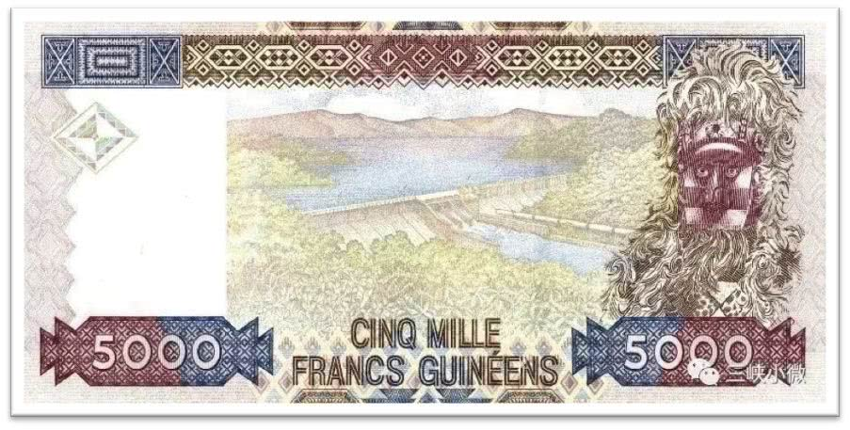
China-Africa cooperation in the power sector
Chinese loans to Africa in the power sector: over 30 billion total commitment, 165 projects
China is not a ‘new’ player in Africa’s power sector
The growth of Chinese loans is tremendous started even before the financial crisis in 2008 and but not linear
Kinkon Hydropower station in Guinea constructed between 1963-1966 by PowerChina
Source: John Hopkins University China Africa Research Initiative Database

Slide 6
Chinese wind and solar PV activities are small but growing:
Country | Plant | Capacity MW | Status | Chinese involvement
Ethiopia | Adama 1 wind plant | 51 | Completed | EPC+ financing[1]
 | Adama II wind plant | 153 | Completed | EPC+ financing
 | Aysha II wind plant | 120 | Under construction | EPC+ financing
Egypt | Benban solar plant | 251.5 | Under construction | Project financing and supplying of technology
South Africa | De Aar phase 1 and 2 wind farms | 244 | Completed | Project developer/sponsor
 | The Golden Valley wind plant | 120 | Under construction | Technology supplier
 | Excelsior wind plant | 109 | Under construction | Technology supplier
 | Klipheuwel-Dassiesklip wind plant | 27 | Completed | Technology supplier
 | Van Stadens wind plant | 27 | Completed | Technology supplier
 | Soutpan Solar plant | 31 | Completed | Equity investor
 | Witkop solar plant | 30 | Completed | Equity investor
 | Lesedi solar plant | 75 | Completed | Technology supplier
 | Letsatsi solar plant | 75 | Completed | Technology supplier
 | Solar Capital Orange[3] |  | Partially completed | Technology suppliers
Kenya | Garissa solar plant | 55 | Completed | EPC + financing
Senegal | Wind plant | 12 | EPC contract signed | EPC contractor
Tanzania | Wind plant | 600 | Unclear | Project developer
Ghana | Solar plant | 20 | Unclear | Project developer
Zimbabwe[4] | Gwanda solar plant | 100 | Unclear | Project developer
Uganda^{[1]} | Solar | 500 | Planned | EPC + financing
Zambia[2] | Solar | 600 | Planned | EPC + financing
Total 9 Countries, 21 project activities with 3.12GW capacity.
Source: Chiyemura and Shen, forthcoming

Slide 7

Are we entering a new age?
How keen are Chinese companies indeed? Between domestic markets, other overseas market, and African market
How can Chinese financial institutions support highly diversified wind and solar energy projects? Financial innovation and risk appetite
Who and how to engage with African stakeholders more constructively? Between institutional development, capacity building, community communication, and sectoral development strategy

