Slide 1
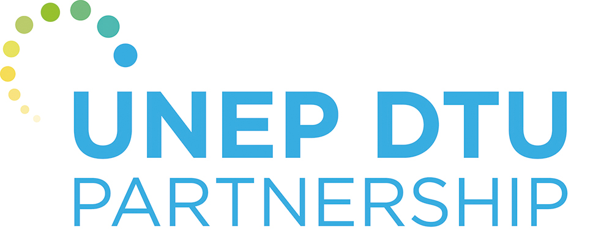
Thank you!
Dr. Ulrich Elmer Hansen - uleh@dtu.dk
Dr. Padmasai Lakshmi Bhamidipati -lakpa@dtu.dk
UNEP-DTU Partnership - https://unepdtu.org/

Slide 2
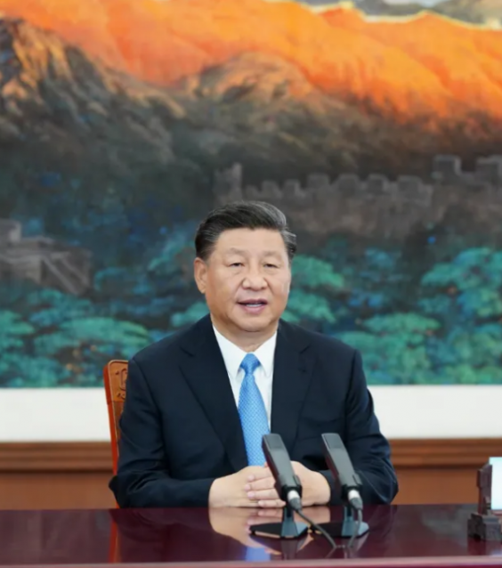
China commits to peaking emissions by 2030 and emissions neutrality by 2060
September 22, 2020 at the UN General Assembly, China commits to enhancing the Nationally Determined Contribution (NDC) under the Paris Agreement.
2020年9月22日，中国在联合国成立75周年高级别会议上承诺，将提高国家自主贡献（NDC）力度，力争于2030年前达到二氧化碳排放峰值，努力争取2060年前实现碳中和。

Slide 3
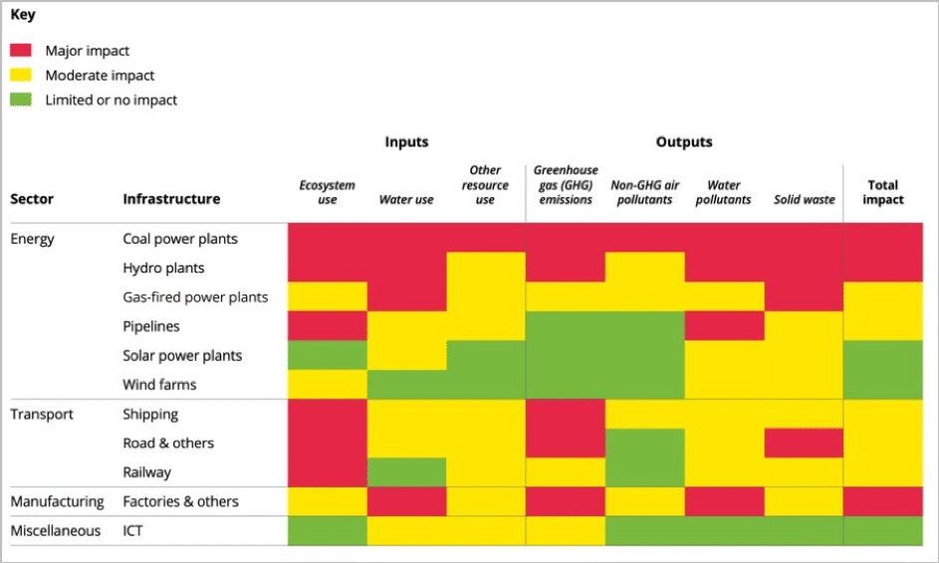
Belt and Road International Green Development Coalition (BRIGC)
Ministry of Ecology and Environment of China: BRI International Green Development Coalition (BRIGC) to promote 2030 Sustainable Development Goals.
NRDC: international partner on environmental laws, regulations and standards
research and development of the "Green Development Guide for BRI" (referred to as the "Traffic Light" mechanism project). The overall goal is to reduce the environmental and climate risks of overseas investment and promote the construction of the Green Belt and Road.
https://green-bri.org/green-light-system-for-the-belt-and-road-initiative
Notes:
In April 2019, the Ministry of Ecology and Environment of China led the establishment of the BRI International Green Development Coalition (BRIGC) which aims to promote the sustainable development of BRI countries and the realization of the United Nations' 2030 Sustainable Development Goals.
NRDC was invited to join the alliance and became an international partner on environmental laws, regulations and standards, focusing on research and knowledge sharing, supporting the establishment of a BRI environmental laws and regulations database, and conducting research on ecological environmental standards, in order to promote the "Belt and Road" national environmental legislation and environmental standards and to improve and carry out cooperation and exchanges.
Since the establishment of BRIGC, it has focused on the research and development of the "Green Development Guide for BRI" (referred to as the "Traffic Light" mechanism project). The overall goal is to reduce the environmental and climate risks of overseas investment and promote the construction of the Green Belt and Road. The specific goal is to provide suggestions and countermeasures for an environmental risk prevention mechanism, deal with the environmental problems throughout the life cycle of projects, and help investors in project screening and assess, carry out environmental risk monitoring and control.

Slide 4
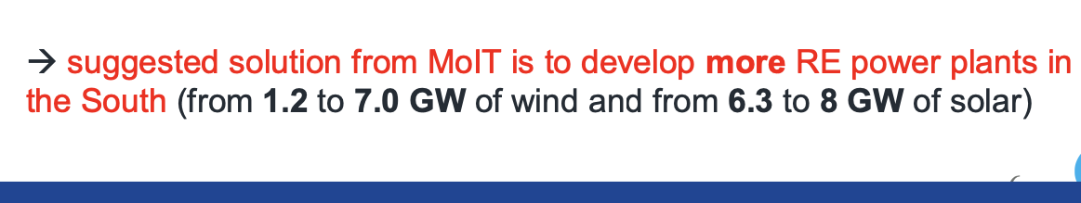
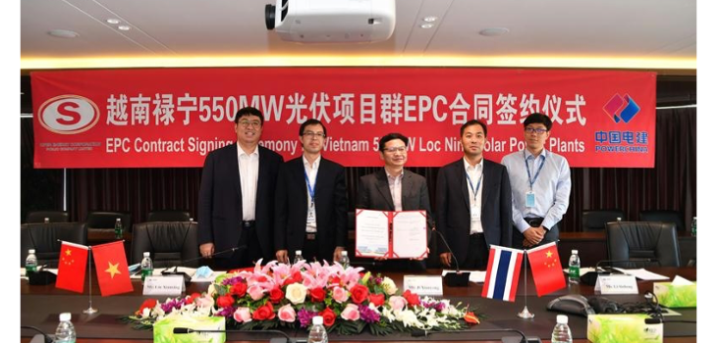
Policy environment：Vietnam Power Development Plan 8
In the past two years, Vietnam has rapidly developed solar and wind power, introduced many renewable energy technologies and project investments, and established a new renewable energy market.
Chinese engineering contractors and manufacturers participated extensively in the bidding and construction, helping Vietnam to take the road of low-carbon development.
Based on the rapid development of the policy landscape in the past two years, the Vietnamese government recently revised its power development plan to support more renewables and be more cautious in the development of new coal power projects.
China Power Construction and Super Energy signed an EPC contract for 550 MW PV capacity in Vietnam through video conferencing. (Photo Credit: China Power Construction Group Co., Ltd.) http://taiyangnews.info/business/chinese-epc-to-construct-550-mw-in-vietnam/
Notes:
1

Slide 5
Summary remarks

