Slide 1
Chinese footprint in Africa’s renewable energy sector Frangton Chiyemura DPP, The Open University, UK
China-Africa cooperation on green energy transition: Potentials and barriers: African perspectives Webinar
17 November 2020

Slide 2
Background
Brief highlight on electricity access challenge in Africa, followed by renewable energy resources endowment in Africa
China’s contributions in Africa’s energy sector
Project financing
Project construction
Technology supply
Thinking ahead

Slide 3
Electricity access challenge in Africa
 | Proportion of the population with access to electricity |  |  |  |  |  |  | Population without access (million)
 | National |  |  |  |  | Urban | Rural
 | 2000 | 2005 | 2010 | 2015 | 2019 | 2019 | 2019 | 2019
WORLD | 73% | 77% | 80% | 85% | 90% | 96% | 85% | 771
Africa | 36% | 40% | 44% | 49% | 56% | 81% | 37% | 579
North Africa | 91% | 97% | >99% | >99% | >99% | >99% | >99% | <1
Sub-Saharan Africa | 24% | 28% | 33% | 40% | 48% | 76% | 29% | 578
Developing Asia | 67% | 74% | 79% | 87% | 96% | 99% | 94% | 155
China | 99% | >99% | >99% | >99% | >99% | >99% | >99% | <1
India | 43% | 58% | 68% | 79% | >99% | >99% | >99% | 6
Indonesia | 53% | 56% | 67% | 88% | >99% | >99% | 99% | 2
Other Southeast Asia | 65% | 75% | 79% | 85% | 91% | 98% | 85% | 36
Other Developing Asia | 38% | 46% | 58% | 73% | 79% | 88% | 74% | 112
Central and South America | 87% | 91% | 94% | 96% | 97% | 99% | 87% | 16
Middle East | 91% | 90% | 91% | 92% | 92% | 98% | 77% | 19
Source: IEA, World Energy Outlook 2020

Slide 4
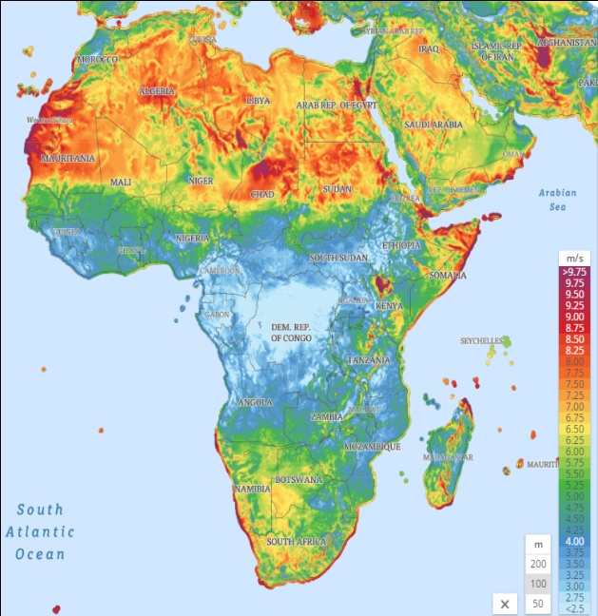
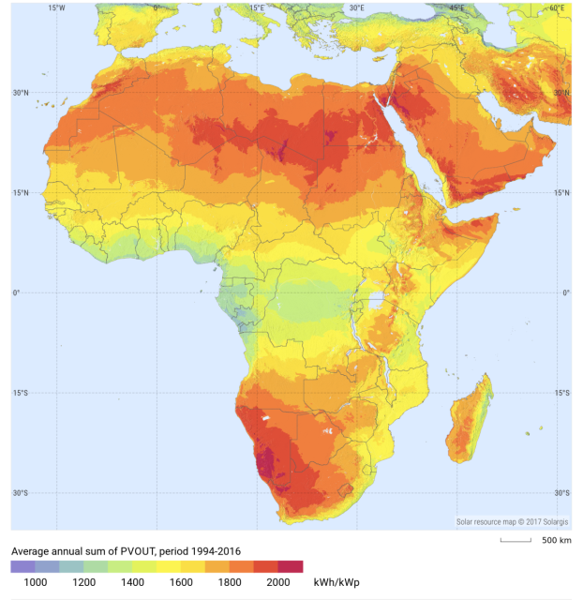
Africa’s wind and solar resources potential
Africa has a technical wind energy resource generation potential of 180,000 TWh per annum. This is 250 times enough to meet electricity demands of the continent (which is 700 TWh) (IFC, Everoze, Vortex and GWEC 2020).
Some African countries have strong winds >8.5 m/s
Algeria is the most endowed country with 7,700 GW potential followed by other 15 with wind energy resources of about 1000 GW.
Africa is endowed with solar energy resources estimated to be more than 660 000 TWh per year. Almost 950 times more than enough to meet the electricity demand of the continent.
With such wind and solar energy potential, transition to renewables is plausible…BUT the progress has been very slow

Slide 5
Total installed capacity from ‘renewable’ energy (both grid and off-grid) by selected countries & regions
Africa’s total installed capacity by ‘renewable’ energy sources
Source: Chiyemura & Shen forthcoming based on IRENA dataset 2020
Africa remains the only continent with lowest deployment of renewables and yet it is massively endowed with renewable energy resources.
Between 2010 and 2018, Africa’s installed generation capacity increased from 155GW to 245GW in which 195GW was deployed from fossil fuel fired capacity and close to 50GW from renewable energy sources. However, of this 50GW, only 4GW was from solar PV and about 5.5 GW from wind.
Why is this the case?

Slide 6
Explaining the slow progress
Financing is one of the biggest challenges affecting the deployment of renewables in Africa
Complex bureaucracy, inconsistence and changing regulations
Institutional inadequacies
Technical capacity

Slide 7
Chinese involvement in Africa’s energy sector
Project financing
Source | Methodology | Timeframe | Project types included | Total volume in Africa
AidData | Media-Based Data Collection (MBDC), Tracking Underreported Financial Flows (TUFF) | Since 2010 | ODA and non-ODA No sub-category | $25.5 billion
SAIS-CARI Energy data base, John´s Hopkins University | Process tracing, filed investigation, Chinese sources | Since 2010 | Loan finance No sub-category | $30.12 billion
China Global Energy Finance Database, Boston University | Similar with SAIS-CARI database | Since 2000 | Energy sector specific, only cover CDB and CHEXIM loans | $41.6 billion
China Global Investment Tracker (CGIT), American Enterprise Institute | No methodology revealed | Since 2005 | All sectors | $96.54 billion
Source: Shen 2020

Slide 8
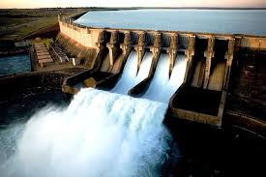
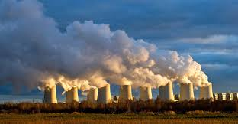
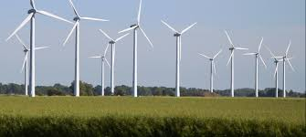
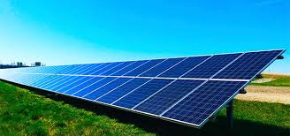
Chinese involvement in Africa’s energy sector
Project construction
Contracted to build 17GW new generation capacity between 2010 and 2020.
Eastern and Southern Africa dominates the new capacity additions at 5.5GW each, followed by 4.2GW in Western Africa and 1.3GW in Central Africa.
More than 90% of Chinese-built power projects were contracted to Chinese SOEs. 80% of these projects were financed by debt financing mainly EXIM & CDB.
Hydropower dominated the new additions at 49%, followed by coal power plants (largely in South Africa) at 20%. Gas power plants were at 19%, oil fired plants at 5% while wind, solar, biomass and waste additions were at 7%.
Source, IEA

Slide 9
Chinese involvement in Africa’s energy sector
Technology supply
Country | Plant | Capacity MW | Status | Chinese involvement
Ethiopia | Adama 1 wind plant | 51 | Completed | EPC+ financing+ technology supply
 | Adama II wind plant | 153 | Completed | EPC+ financing + technology supply
 | Aysha II wind plant | 120 | Under construction | EPC+ financing +technology supply
Egypt | Benban solar plant | 251.5 | Under construction | Project financing and supplying of technology
South Africa | De Aar phase 1 and 2 wind farms | 244 | Completed | Project developer/sponsor
 | The Golden Valley wind plant | 120 | Under construction | Technology supplier
 | Excelsior wind plant | 109 | Under construction | Technology supplier
 | Klipheuwel-Dassiesklip wind plant | 27 | Completed | Technology supplier
 | Van Stadens wind plant | 27 | Completed | Technology supplier
 | Soutpan Solar plant | 31 | Completed | Equity investor
 | Witkop solar plant | 30 | Completed | Equity investor
 | Lesedi solar plant | 75 | Completed | Technology supplier
 | Letsatsi solar plant | 75 | Completed | Technology supplier
 | Solar Capital Orange |  | Partially completed | Technology suppliers
Kenya | Garissa solar plant | 55 | Completed | EPC + financing
Senegal | Wind plant | 12 | EPC contract signed | EPC contractor
Tanzania | Wind plant | 600 | Unclear | Project developer
Ghana | Solar plant | 20 | Unclear | Project developer
Zimbabwe | Gwanda solar plant | 100 | Unclear | Project developer
Uganda | Solar | 500 | Planned | EPC + financing
Zambia | Solar | 600 | Planned | EPC + financing
21 project activities with 3.12GW capacity. Source: Chiyemura and Shen, forthcoming

Slide 10
Conclusion: Thinking ahead
Renewable energy sources can play an important role in addressing Africa’s electricity access challenge.
Considerable progress has been made especially on the generation side, but more attention must be devoted to transmission and distribution for which Chinese enterprises can play a role.
Financing and institutional inadequacies remain the biggest challenges affecting the deployment of renewables in Africa.
Debt financing with sovereign guarantee is no longer sustainable. Equity financing can play a meaningful role. However, it is by and large perceived by project financiers as a high risk endeavour. What lessons can we learn from e.g. SA’s Renewable Energy Independent Power Producer Programme (REIPPP)? And are Chinese financiers/project developers willing to adopt this model?

Slide 11
THANK YOU

