Slide 1



Sino-African relations in renewable energy generation – Insights from Kenya
Ulrich Elmer Hansen &
Padmasai Lakshmi Bhamidipati
UNEP DTU Partnership
Technical University of Denmark

Slide 2
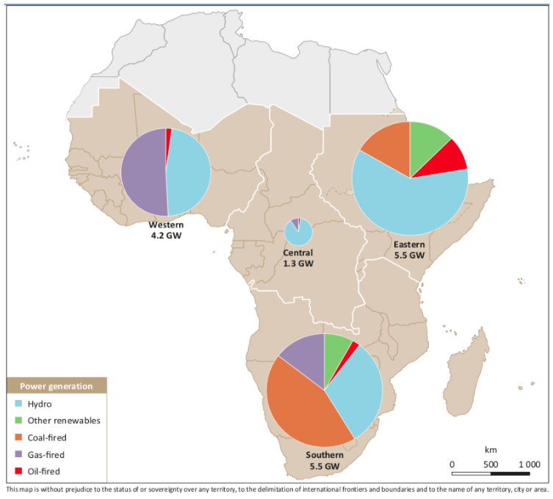
Background
Growing influence of China in Africa's renewable energy sector (IEA 2016; Shen 2020).
Most previous research focuses on hydropower (e.g. Hensengerth 2018).
Less research on wind and solar PV: rapidly emerging in Africa (2009-2018).
  Installed wind power capacity: 108 to 6,100 MW.
  Installed solar PV capacity: 739 to 5,500 MW (IRENA 2019).
Prior research on China´s engagement focuses on at macro/aggregate level.
Focus on the agency of Chinese actors (motives/strategic interests of state/firms).
Binary perspectives dominate:
  Dominant scepticism - Chinese role in exploitation/colonialism.
  Chinese influence is seen as inherently beneficial.
Need for a more balanced view, and in-depth empirical knowledge.
Introduce more African agency into the analyses.
Source: IEA 2016

Slide 3
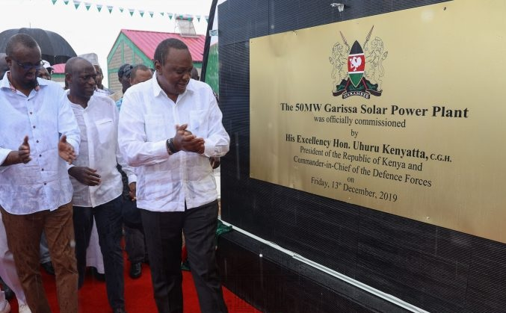
Insights from the Garissa project in Kenya
Solar project: First large-scale PV project in East Africa (50 MW) - Dec 2019.
Located in Garissa county, north-eastern part of Kenya, border conflict area.
Chinese-led: project developer (Jiangxi Province), finance (Exim bank), technology (Jinko solar), EPC contractor (CJIC).
Kenyan-actors: project owners (Rural Electrification Authority-REA and Ministry of Energy-MoE).
Exploratory study of 'frictional encounters' between Chinese and local actors.
  Two types of encounters: Employment and community development.
Data sources: Interviews and focus-group discussions (Chinese/local actors), documents, webpages.
Project organisation (Chinese
ownership)
Frictional encounters between actors
Development impacts: employment, community development
Notes:
We draw here on insights from our research on a specific solar power project in Kenya, which will be published soon (we hope)
Interviews mostly focused on the pre-construction and the construction phase of the project

Slide 4
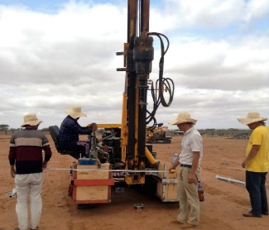
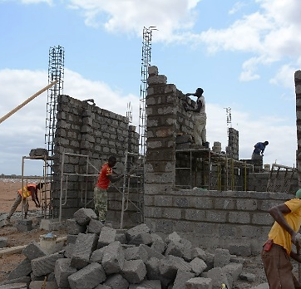
Local Employment
Mainly use of local labour (85%) in construction phase; half (4 Kenyan, 5 Chinese) in operation phase.
Capital-intensive + emphasis on efficiency (costs and timeline).
Type of local jobs in construction phase - mostly unskilled from nearby areas, some semi-skilled from towns.
Casualisation of workforce – no formal contracts, wage assurance, medical benefits.
Capacity building of Kenyan O&M employees, REA staff, Kengen staff.
Several Chinese workers employed had previously worked in North Africa and West Africa on infrastructure projects.

Slide 5
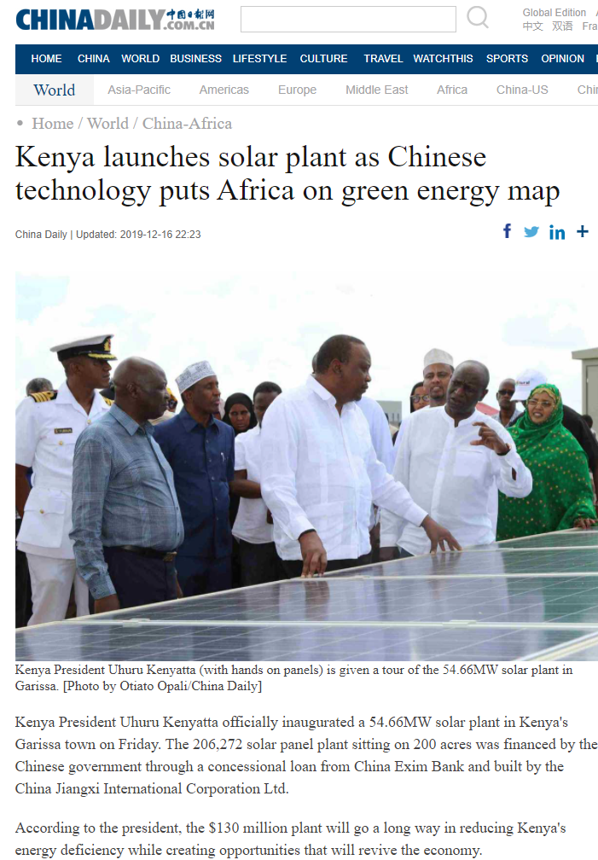
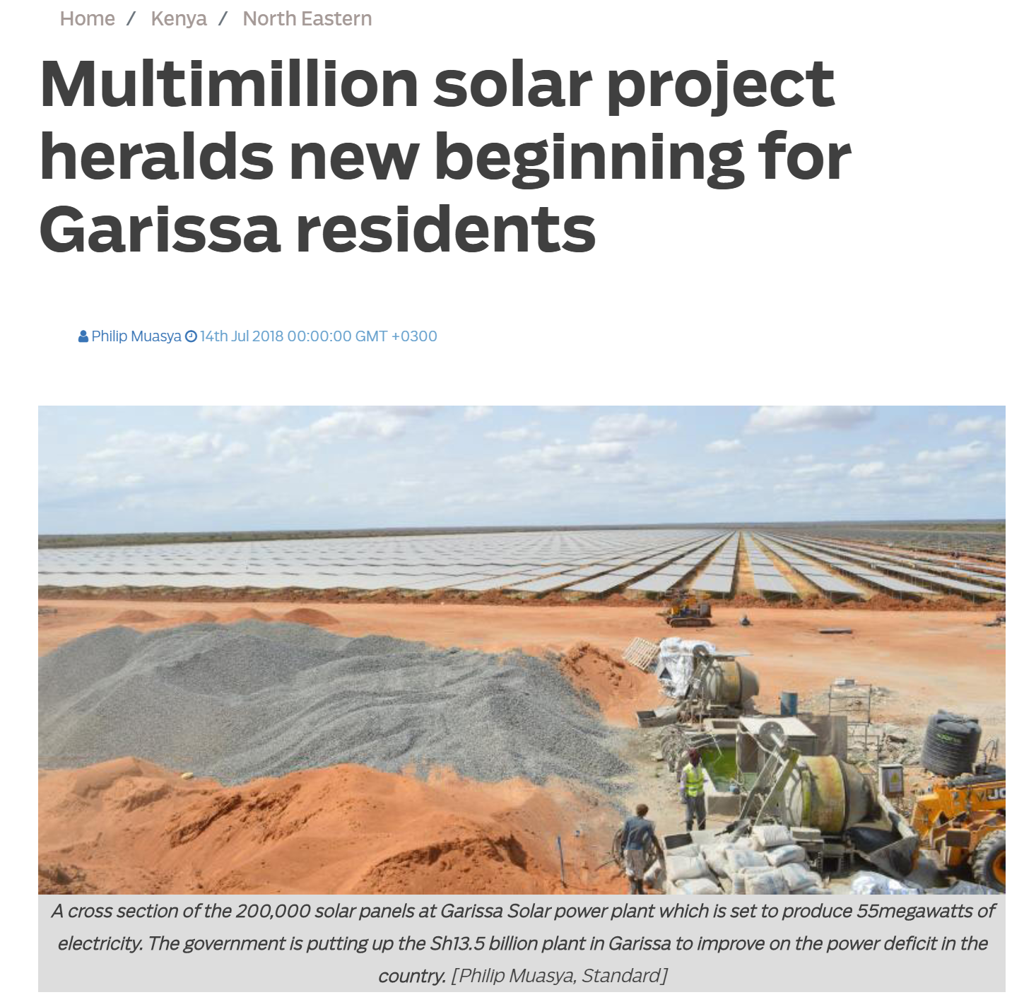
Community Engagement
The absolute number of local workers/jobs was still low vs the promises made early on.
Pastoral land diverted - legal ownership, compensation remained unresolved throughout the construction phase.
Sense of exclusion & alienation with fencing.
Lack of Kenyan govt. staff onsite / communication gaps.
Local mobilisation and opposition (including sabotage).
Clear inclination for high local content.
Project wouldn't provide electricity to nearby villages.
Land issue - One land parcel on the planned transmission route.
Multiple versions of CD discussed without a clear agreement.
Construction started with boundary wall + office buildings + ground levelling.
Use of heavy machinery.
REA played a key role in mediating; re-engaged with the community.
Assured formal contract-based employment in the O&M phase.
Renewed iterations, negotiations with regard to CD activities (change in local county leadership).
Expediting implementation of CD activities - school, health centre, roads, water pipelines.

Slide 6
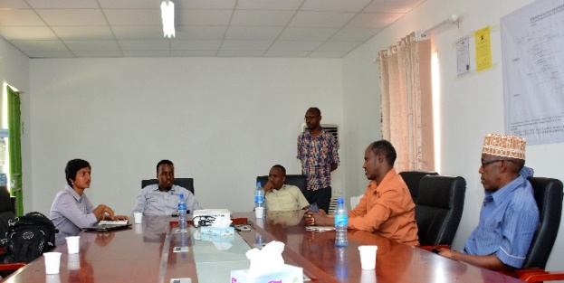
Local Agency / Micro-politics
The local communities actively conveyed their expectations and concerns with regard to the project, as well as their needs pertaining to local development initiatives early on.
They engaged in mobilisation efforts, resisted the project’s construction and expressed dissatisfaction over the limited number of local jobs generated.
Representatives of the local county and community leaders also actively negotiated and emphasised community development activities and demanded formal employment for Kenyan staff in the project’s operations compared to what was promised.
Local county representatives found it opportune to re-assert their power in relation to national government actors.

Slide 7
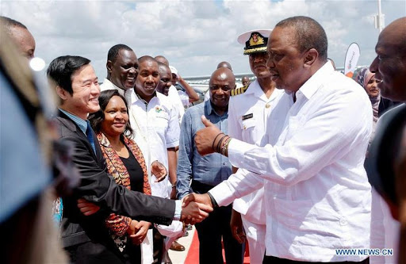
Developmental Implications
The overall developmental outcomes are favourable when viewed from the perspective of a completed project (with minimal delays) contributing to a sustainable energy mix, local infrastructural improvements, some local employment and the reinforcement of local political leadership.
The involvement of a Kenyan engineering consultancy firm is
strategic in ensuring local transfer of capabilities.
Local trainings, skill development limited; and limited scope
for local firms due to tied-financing.
But there was scope for more…
The findings presented raise a question about the role of government in, for example, ensuring more local content, capacity-building and skills transfers for the local employees involved in the projects.
A targeted approach could be devised by national governments to involve domestic institutions as well as local actors (e.g. construction contractors) so as to maximise the development benefits of such projects further.

Slide 8
Concluding Points
What are the contributions of such a micro-level case study?
Provides more nuances to the prevailing binary narrative of China's role in terms of good vs. bad.
Brings to focus African agency and the deliberate need for strategic intervention.
Micro-level perspective: starting point for opening the 'black box' of Sino-African relations in renewable energy projects.
'Frictional encounters': a process involving three main sequential steps over time with its own distinctive features
  Emergence, escalation and de-escalation/negotiation.
  Involving three main actors: project owners, project contractors and local community actors.

