Slide 1
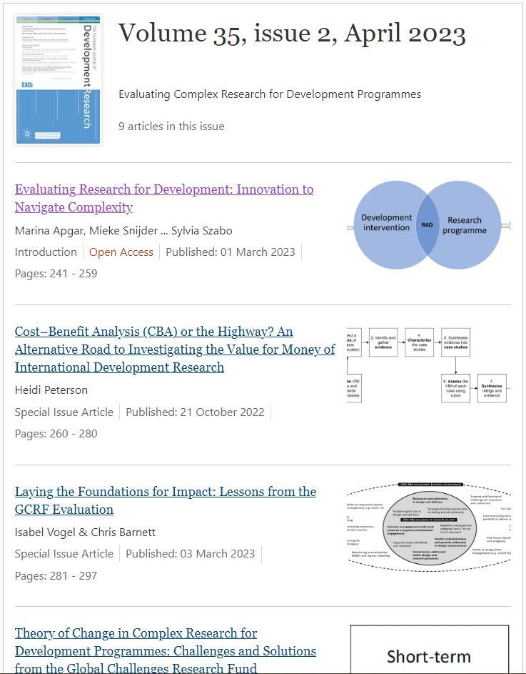
Evaluating complex research for development programmes: innovation to navigate complexity
Launch of EJDR special issue
CDI seminar
20 April 2023; 1 – 2.30pm BST
Chair: Dr Mieke Snijder
Speakers:
Dr Marina Apgar
Arlene Gonzales
Dr Carren Duffy
Genowefa Blundo-Canto
Dr Evelyn Pauls
Discussant:
Prasanna Saligram
Notes:
Welcome everyone, I am very excited to be chairing today’s CDI seminar in which we will be celebrating the publication of our special issue in the European Journal of Development Research on Evaluating complex research for development programmes: innovation to navigate complexity

Slide 2
The special issue
Editors: Marina Apgar, Mieke Snijder, Grace Lyn Higdon and Sylvia Szabo
8 papers – 59 authors
Papers on specific evaluation methods/approaches: social network analysis; impact weaving; outcome trajectories.
Papers on approaches to evaluating: equitable partnerships, value for money; contribution to SDGs; impact at early stages.
Paper on developing Theories of Change for complex R4D

Slide 3
Today’s webinar
Introducing the special issue: Dr Marina Apgar
Theory of Change in Complex R4D Programmes: Dr Carren Duffy
Evaluating R4D contributions to SDGs: Arlene Gonzales
Impact Weaving: An Approach to Strengthening the Plausibility of Anticipated AR4D Impact Pathways: Genowefa Blundo-Canto
Evaluating relational dimensions of R4D through social network analysis: Dr Evelyn Pauls
Discussant: Prasanna Saligram (George Institute for Health – India)
Q&A and panel discussion

